Slide 1
Performance Evaluation of Off-grid Mesh Network Communication Using goTenna and Meshtastic
Midterm Presentation
Team: GO duck
Gwangyeok Kim, Keonwoo Lim, Yeonguk Maeng, Sujee Noh

Slide 2
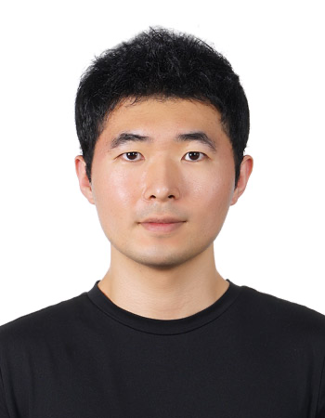
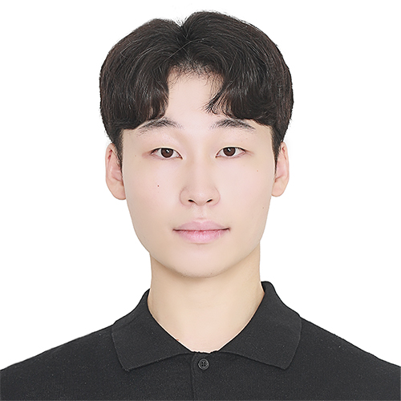
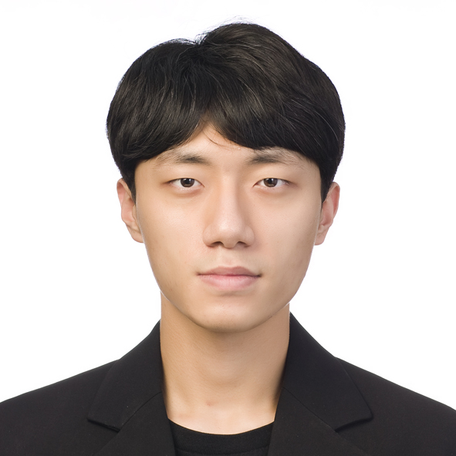
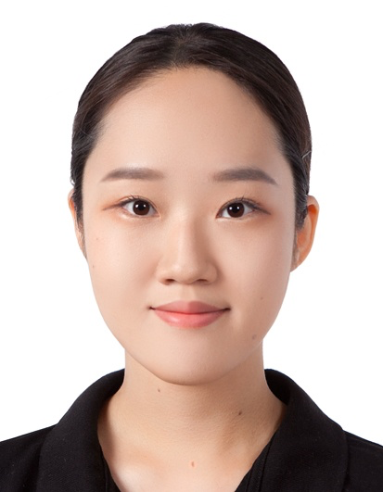
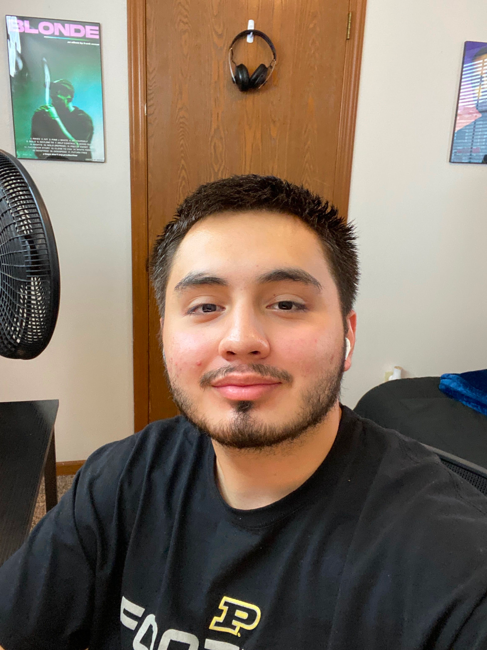

Team Members
Gwangyeok Kim (Leader)
Keonwoo Lim
Younguk Maeng
Sujee Noh
Xavier Lopez
Baylasan Al Shubbar

Slide 3
Introduction
01

Slide 4
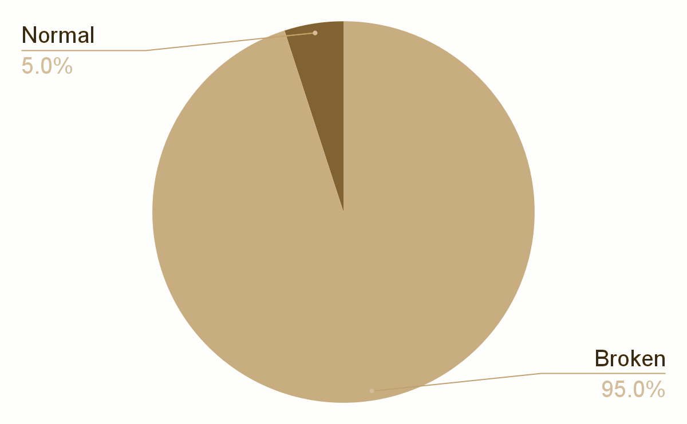
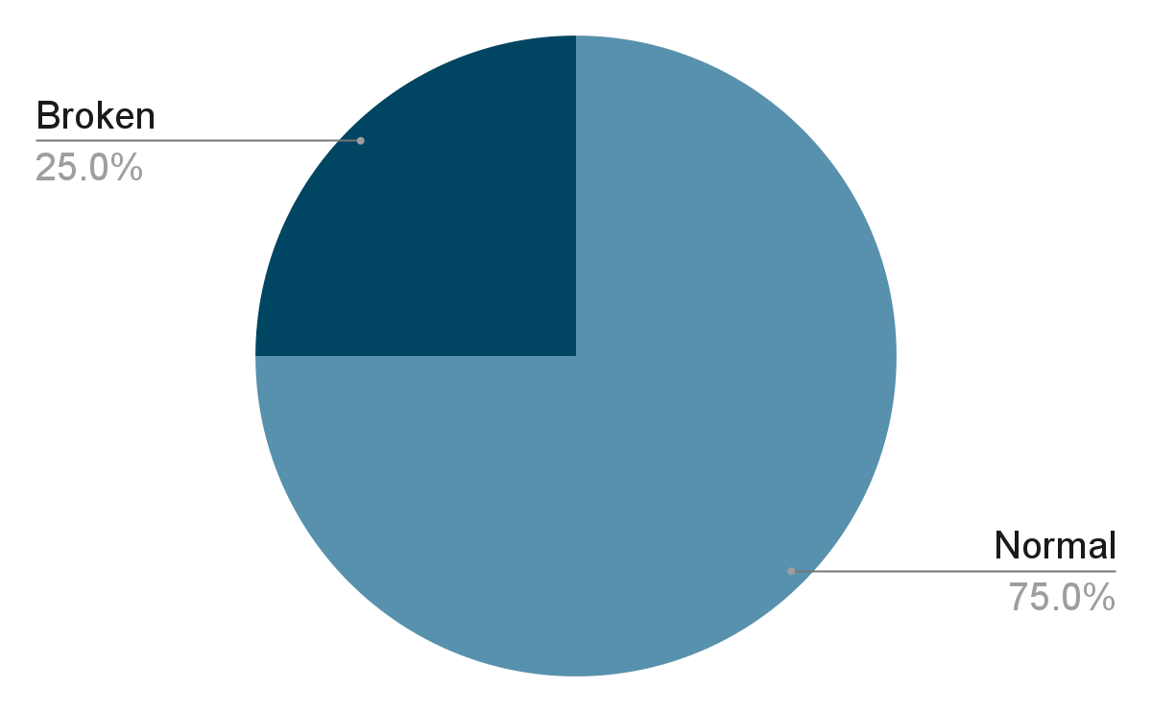
Infrastructure reliability in disaster
Hurricane Maria left 95% of the island with no cell phone service^{[1]}
Hurricane Sandy knocked out 25% of cell towers^{[2]}
[1] David Turetsky, "Remarks of David S. Turetsky, PSHSB Chief," Charlotte, NC, USA. Accessed: Jan. 19, 2023. [Online]. Available: https://www.fcc.gov/general/public-safety-and-homeland-security-bureau-chief-speeches
[2] J. Bacon. "Why Puerto Rico faces a monumental recovery effort," usatoday.com. https://www.usatoday.com/story/news/nation/2017/09/26/why-puerto-rico-faces-monumental-recovery-effort/703515001/\# (accessed Jan. 20, 2023).
Notes:
A woman tries to make a call from her car, pulled over on a highway north of San Juan, Puerto Rico after Hurricane Maria devastated the island’s communications infrastructure.
(https://www.theverge.com/2017/9/29/16372048/puerto-rico-hurricane-maria-2017-electricity-water-food-communications-phone-internet-recovery)

Slide 5
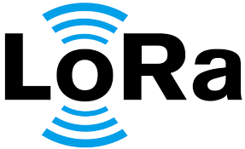
LoRa Communication
LoRa (Long Range Radio)
Solution to short range communication (Wi-Fi, Bluetooth)
Low power
Low bit rate
Low cost
Long battery life
_{[3]}
[3] AKCP, “What is LoRa?,” Accessed: Jan. 29, 2023. [Online]. Available: https://www.akcp.com/blog/what-is-lora/

Slide 6
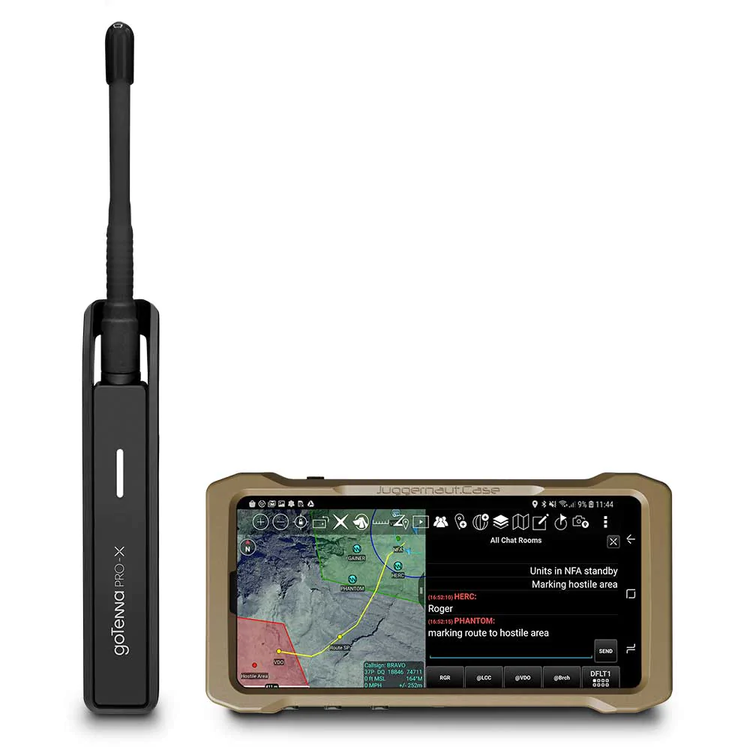


LoRa based Communication Tools
_{[4]}
_{[5]}
_{[6]}
ClusterDuck
goTenna
Meshtastic
[4] Project OWL, “CDP_LOGO.png,” Accessed: Jan. 29, 2023. [Online]. Available: https://www.project-owl.com/assets/CDP_LOGO.png
[5] goTenna, “gotennaprox_comp3v2.jpg,” Accessed: Jan. 29 2023 [Online]. Available: https://cdn.shopify.com/s/files/1/0046/7524/0005/products/gotennaprox_comp3v2.jpg?v=1611262676
[6] Meshtastic, “social-preview-1200x630.png,” Accessed: Jan. 29 2023 [Online]. Available: https://meshtastic.org/design/web/social-preview-1200x630.png

Slide 7
goTenna vs Meshtastic
02

Slide 8
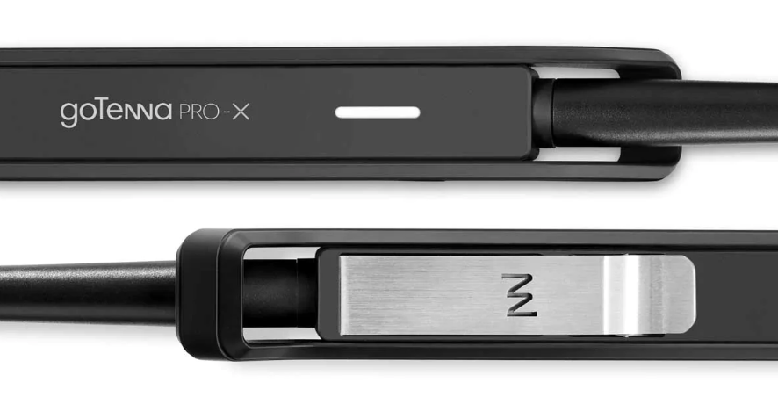
goTenna
_{[7]}
What is goTenna?
A long-range, lightweight device for mobile mesh networking.^{[9]}
Pairs with a smartphone, and enables simple message communication in an environment without cell or WiFi.
Use Aspen Grove Network
[5] goTenna, “gotennaprox_comp2_640x.jpg,” Accessed: Jan. 29 2023 [Online]. Available: https://cdn.shopify.com/s/files/1/0046/7524/0005/products/gotennaprox_comp2_640x.jpg?v=1611262676
[9] R. Ramanathan, C. Servaes, W. Ramanathan, A. Dusia and A. S. Sethi, "Long-Range Short-Burst Mobile Mesh Networking: Architecture and Evaluation," in \emph{Proc. 2019 16th Annu. IEEE Int. Conf. on Sensing, Commun., and Netw. (SECON)}, Boston, MA, USA, 2019, pp. 1-2, doi: 10.1109/SAHCN.2019.8824803.
Notes:
This technology, known as Aspen Grove™, allows for long-range, short-burst mobile mesh networking through a unique approach that uses no control-packets to achieve optimal network efficiency
it broadcasts information and creates a decentralized mesh network, allowing users to send texts and share locations in a group chats and private messages using an app on their device

Slide 9
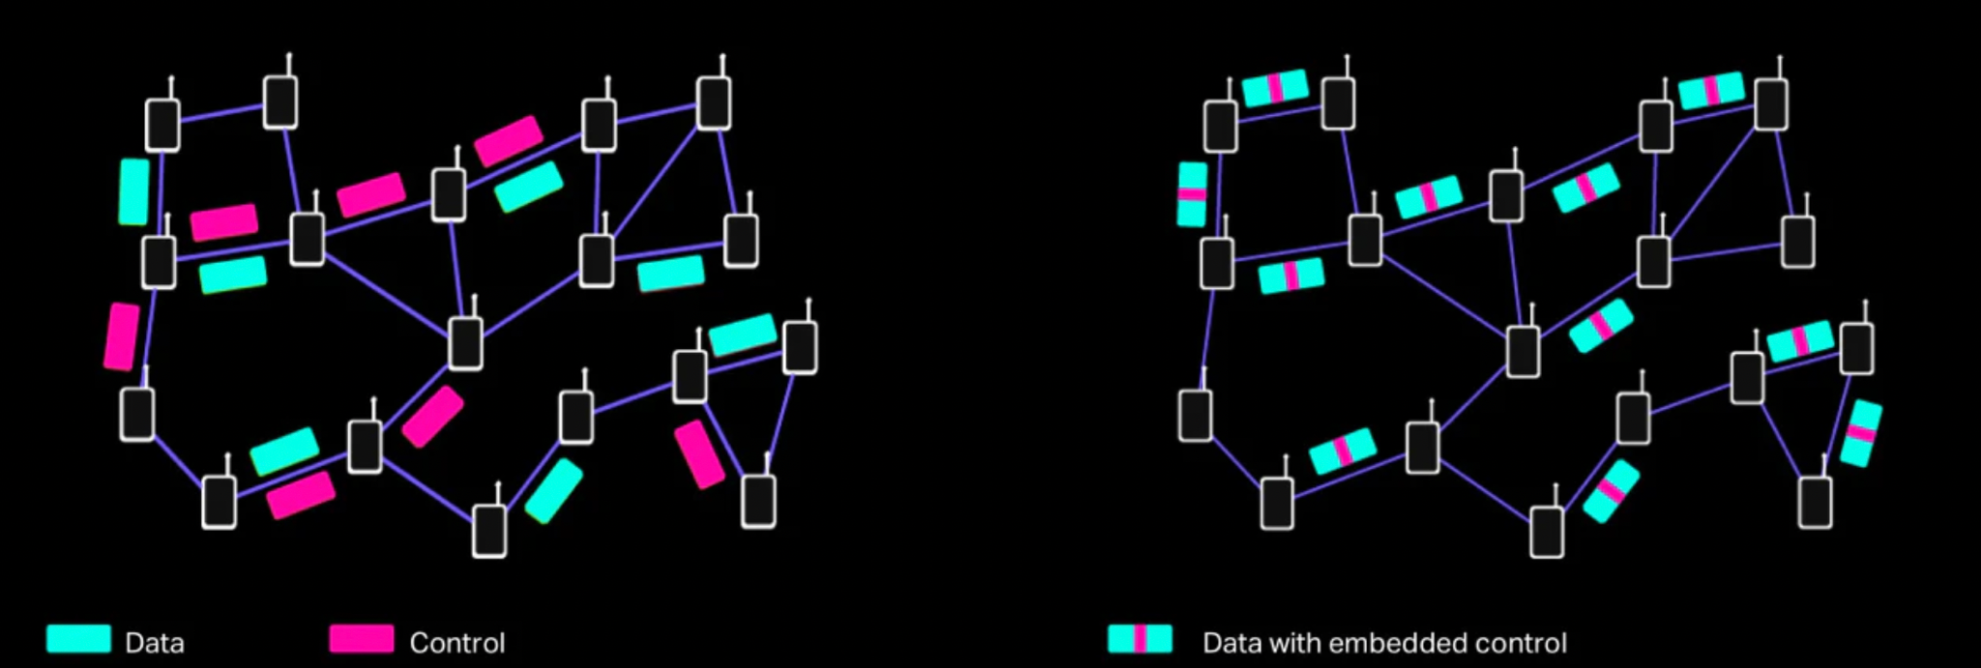
goTenna - Aspen Grove
What is Aspen Grove?
Traditional Mesh Network
Aspen Grove
_{[8]}
Mesh network is called “Aspen Grove”, interconnected root system of a single aspen tree.
Aspen Grove™, allows for long-range, short-burst mobile mesh networking through a unique approach that uses zero control-packets to achieve optimal network efficiency.
[8] goTenna, “What makes goTenna's mesh protocol unique?,” Accessed: Jan. 29 2023 [Online]. Available: https://gotenna.com/pages/aspen-grove
Notes:
This technology, known as Aspen Grove™, allows for long-range, short-burst mobile mesh networking through a unique approach that uses no control-packets to achieve optimal network efficiency
High Scalability
it broadcasts information and creates a decentralized mesh network, allowing users to send texts and share locations in a group chats and private messages using an app on their device

Slide 10
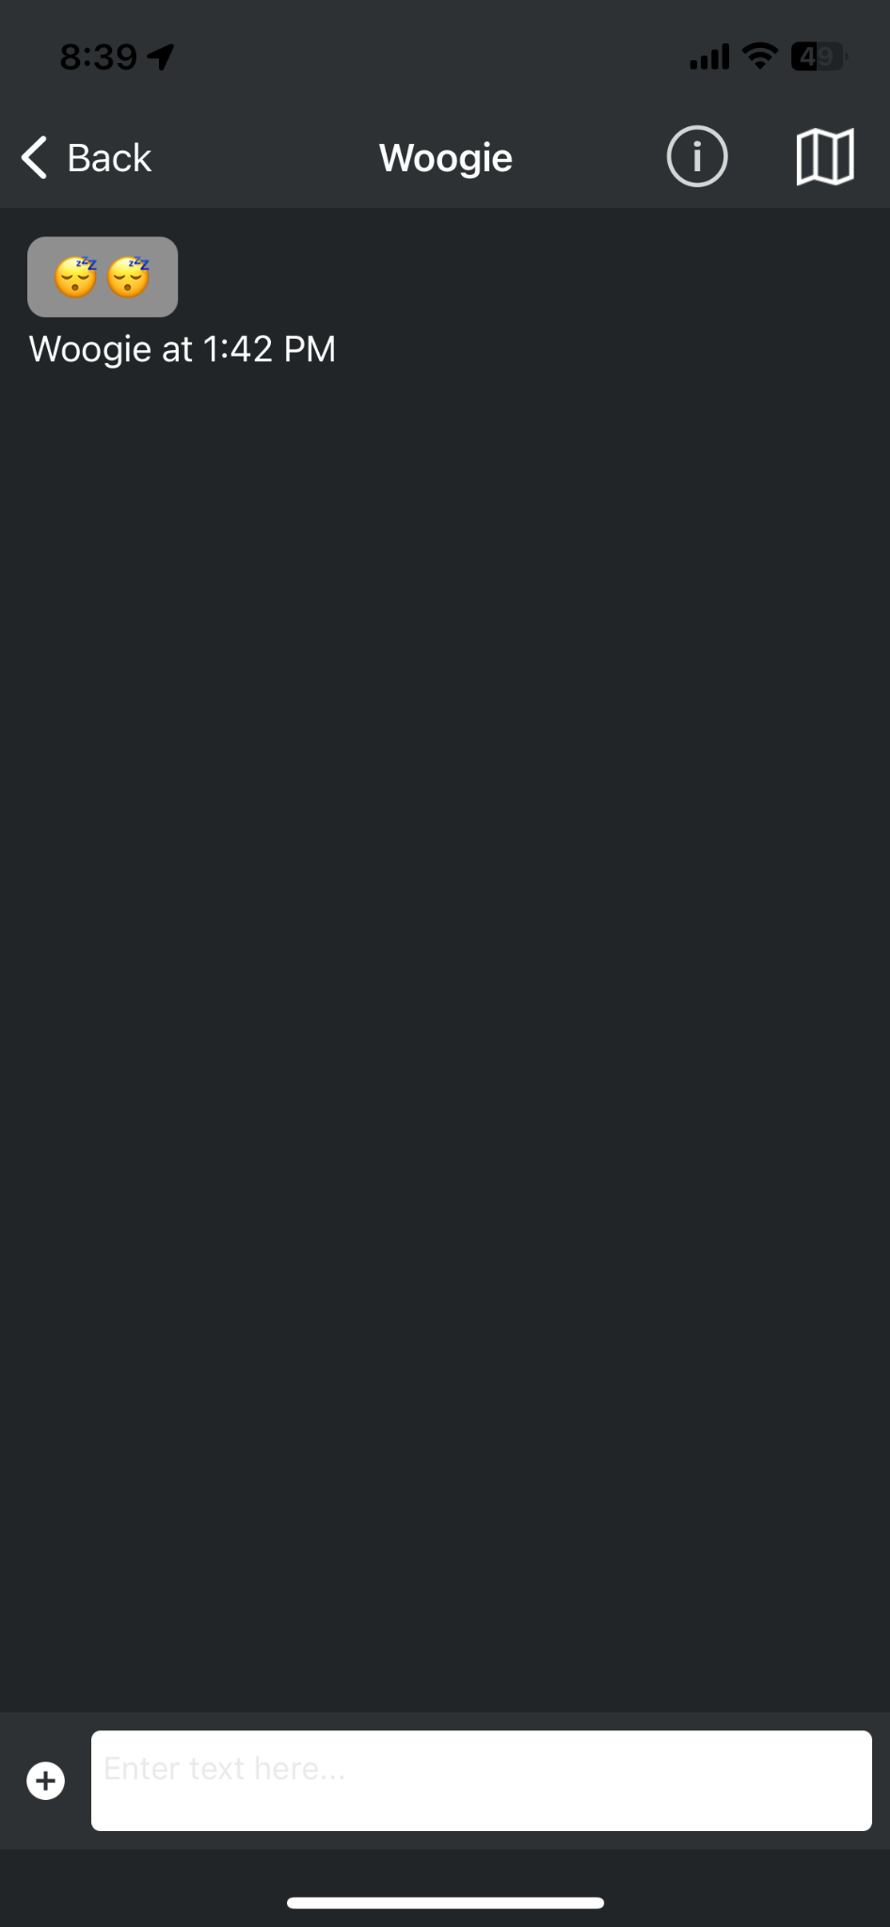
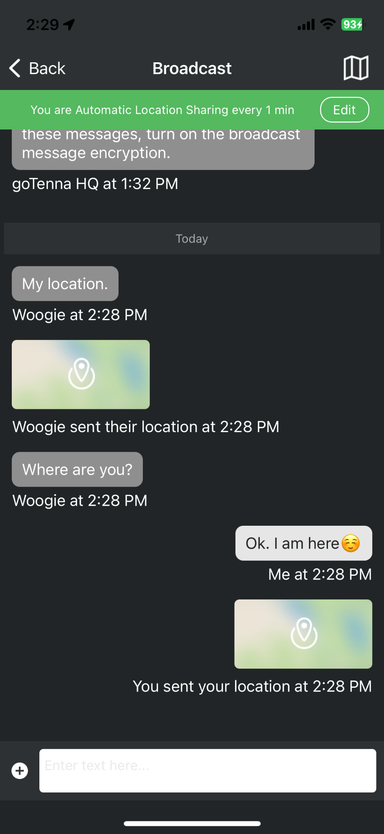
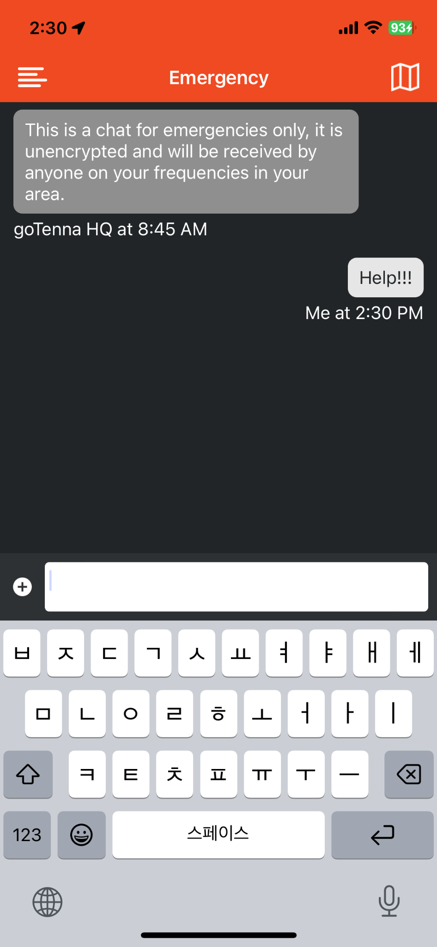
goTenna - chat
Private Chat
Broadcast chat
Emergency chat
Notes:
frequency setting
emergency message is unencrypted

Slide 11
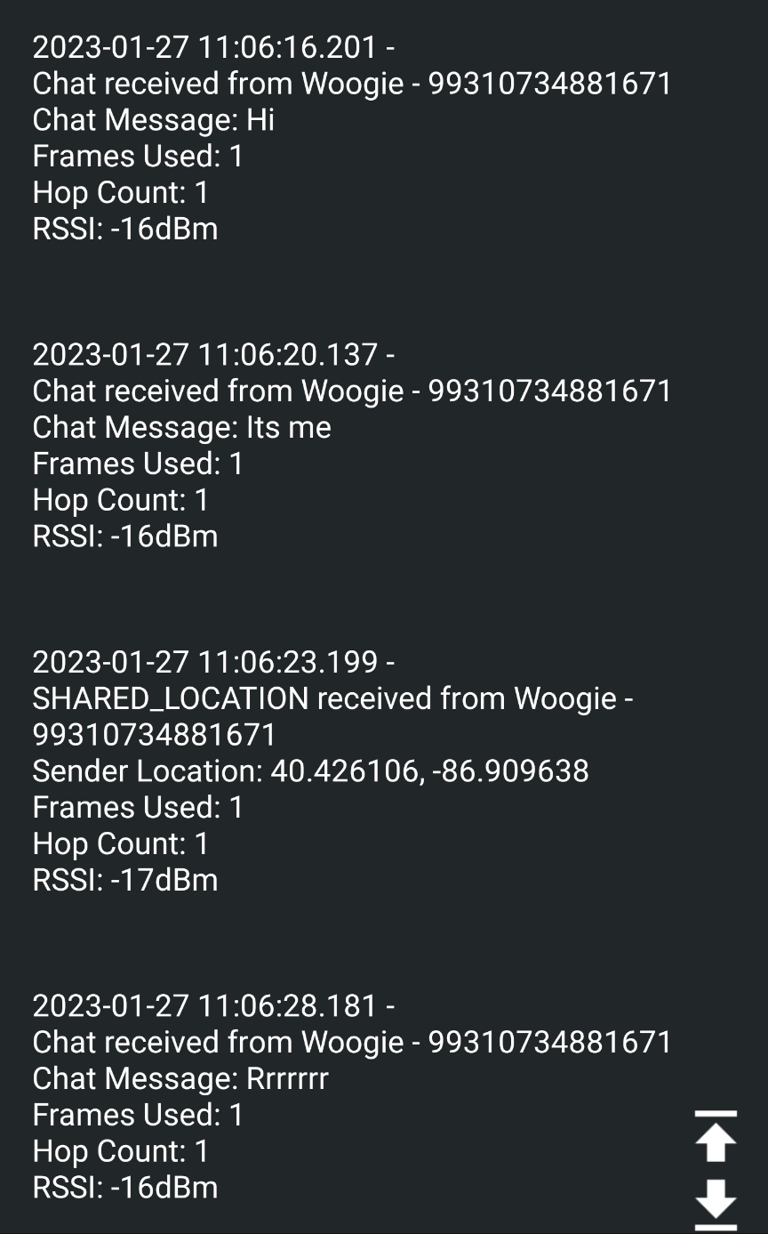
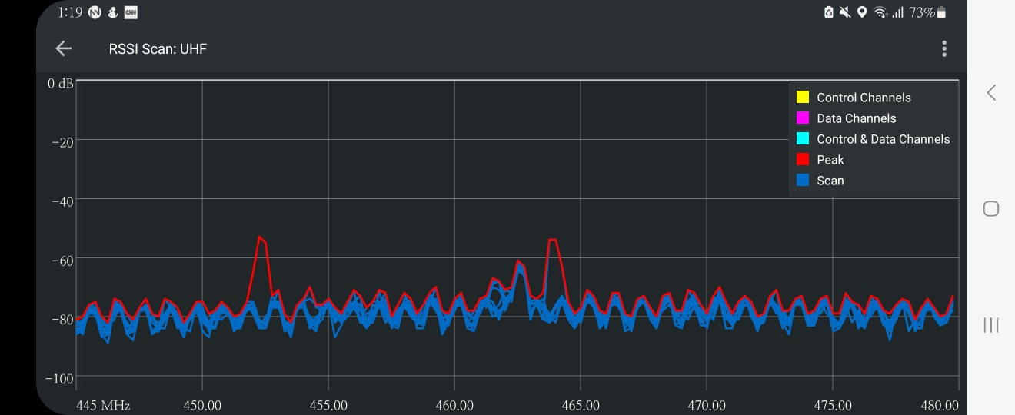
goTenna - measurement
Spectrum Analyzer and Diagnostic Logs supported by goTenna Pro application
Examples of data collected:
Date and Time
Frames Used
Hop Count
RSSI (Received Signal Strength Indicator)
Sender
Message
GPS location
Diagnostic Logs
Spectrum Analyzer
Notes:
고테나 클러스터덕 테스트 하는 방법 (+사용방법, setting 방법, 무슨 정보를 읽어들일지)

Slide 12
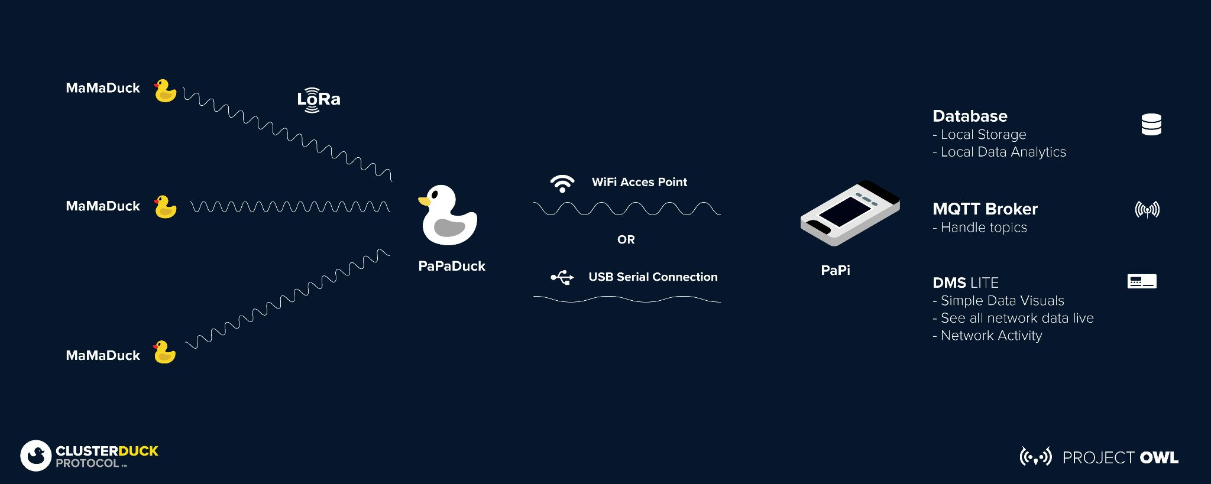
No More ClusterDuck
Convoluted project - Inconsistent performance
OS compatibility issue - No ease of data collection
Notes:
This technology, known as Aspen Grove™, allows for long-range, short-burst mobile mesh networking through a unique approach that uses no control-packets to achieve optimal network efficiency
it broadcasts information and creates a decentralized mesh network, allowing users to send texts and share locations in a group chats and private messages using an app on their device

Slide 13
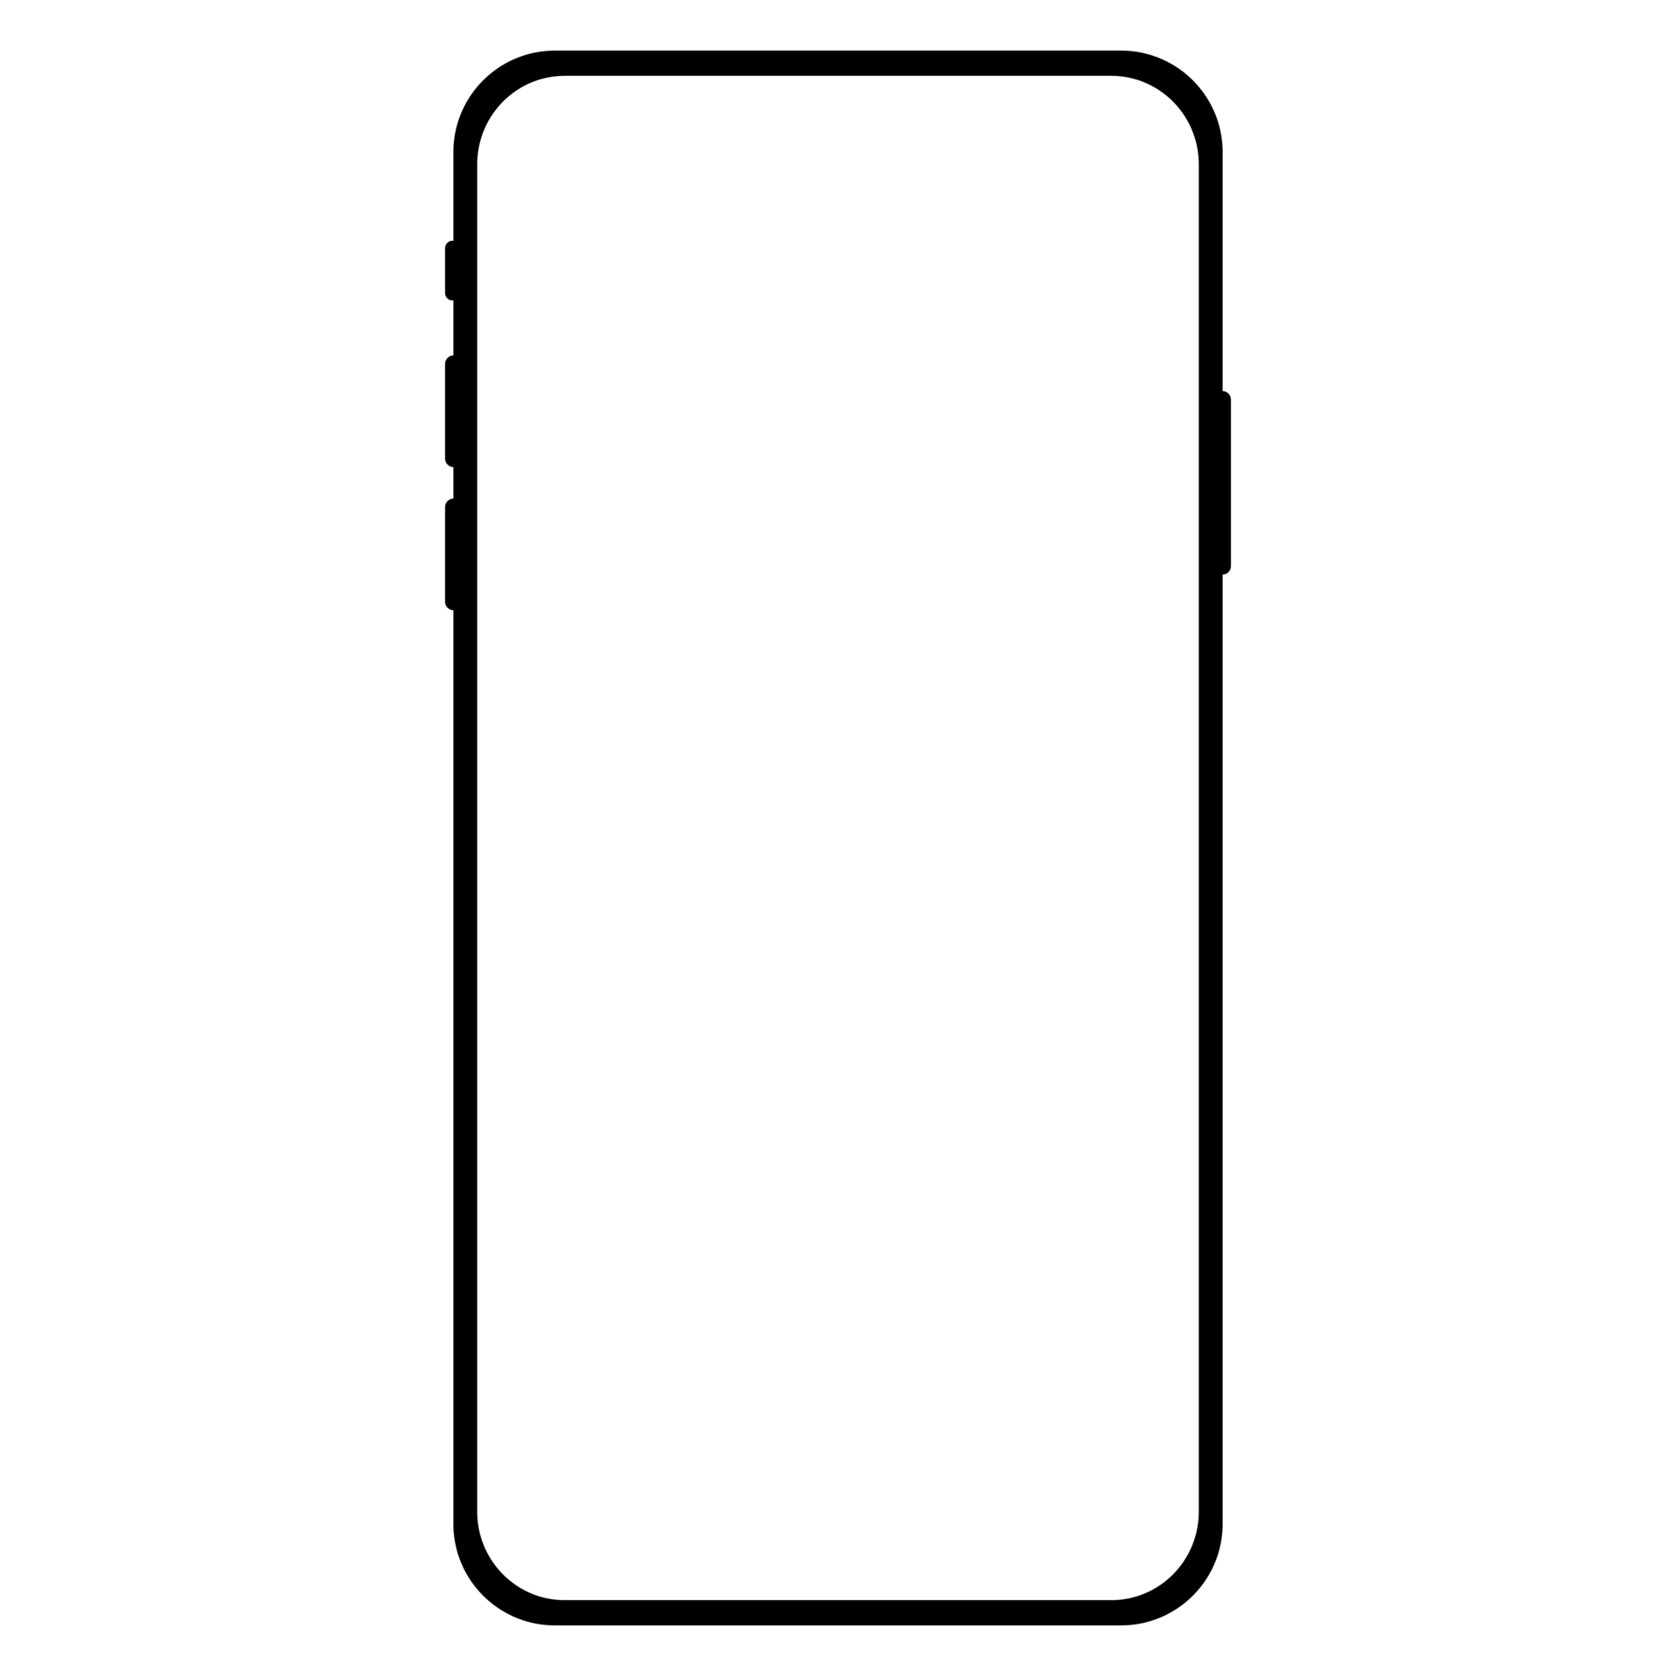
Meshtastic
_{[6]}
_{[11]}
What is Meshtastic?
Off-grid messaging using cost-effective hardware to create your personal mesh^{[10]}
Using their own “Mesh Broadcast Algorithm”
AES256 encryption
Long Battery Life
Open-source project
[10] Meshtastic, “Introduction,” Accessed: Jan. 29 2023 [Online]. Available: https://meshtastic.org/docs/introduction
[11] vecteezy, “smartphone-and-mobile-phone-free-png.png,” Accessed: Jan. 29 2023 [Online]. Available: https://static.vecteezy.com/system/resources/previews/011/047/536/original/smartphone-and-mobile-phone-free-png.png
Notes:
This technology, known as Aspen Grove™, allows for long-range, short-burst mobile mesh networking through a unique approach that uses no control-packets to achieve optimal network efficiency
it broadcasts information and creates a decentralized mesh network, allowing users to send texts and share locations in a group chats and private messages using an app on their device

Slide 14
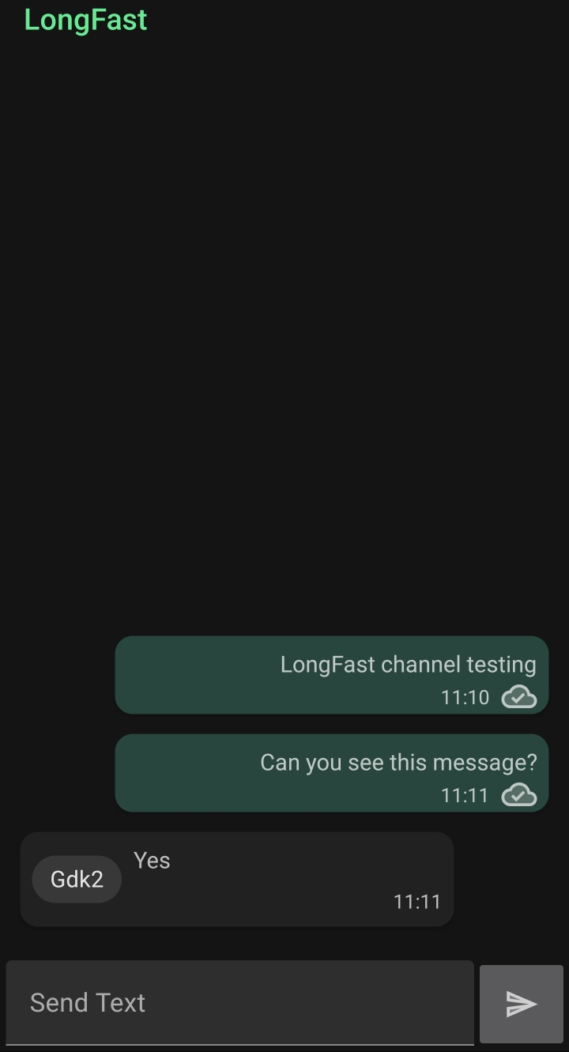
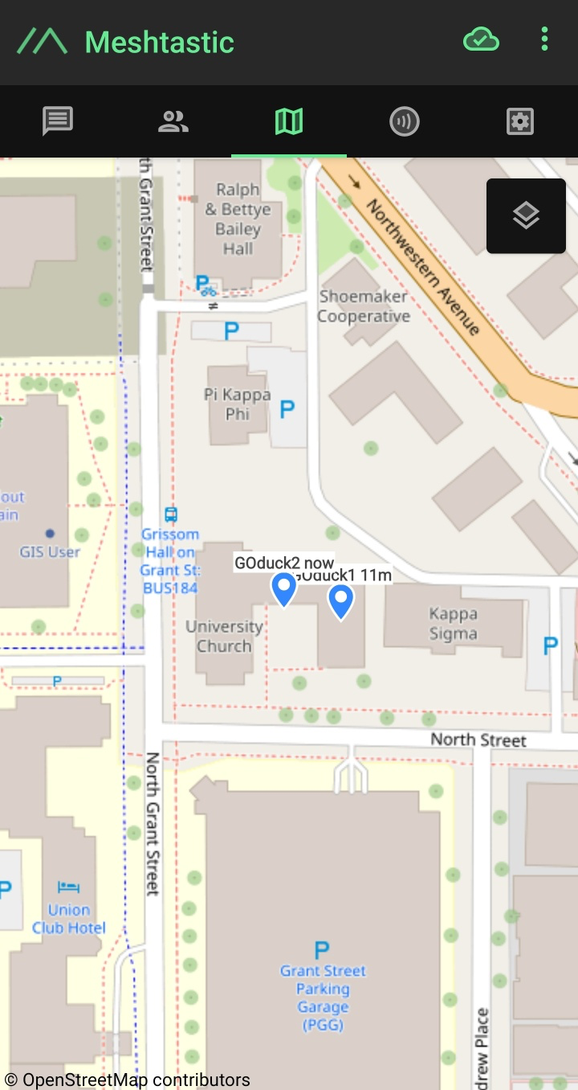
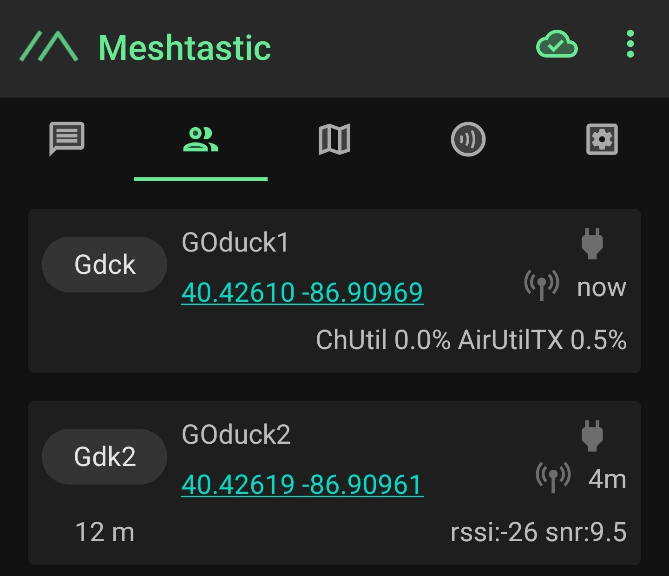
Meshtastic - interface
Private Chat
Friend Window
Map
Notes:
This technology, known as Aspen Grove™, allows for long-range, short-burst mobile mesh networking through a unique approach that uses no control-packets to achieve optimal network efficiency
it broadcasts information and creates a decentralized mesh network, allowing users to send texts and share locations in a group chats and private messages using an app on their device

Slide 15
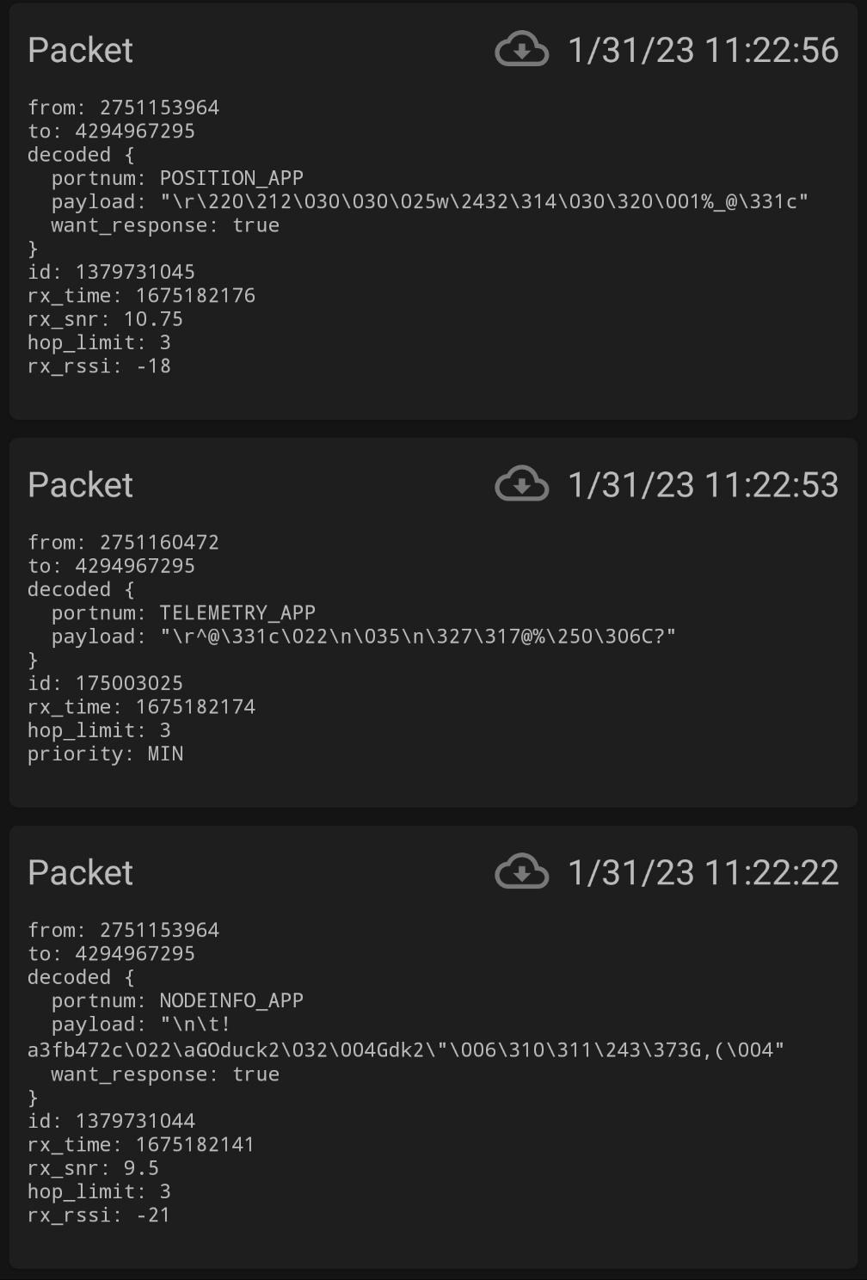
Meshtastic - measurement
Debug Panel provided in the app
Serial Monitor Logs
Examples of data collected:
Time stamp
Packet
Hop Count
RSSI (Received Signal Strength Indicator)
SNR (Signal to Noise Ratio)
Sender
Message
GPS location
Debug Panel
Notes:
고테나 클러스터덕 테스트 하는 방법 (+사용방법, setting 방법, 무슨 정보를 읽어들일지)

Slide 16
Methodology
03

Slide 17
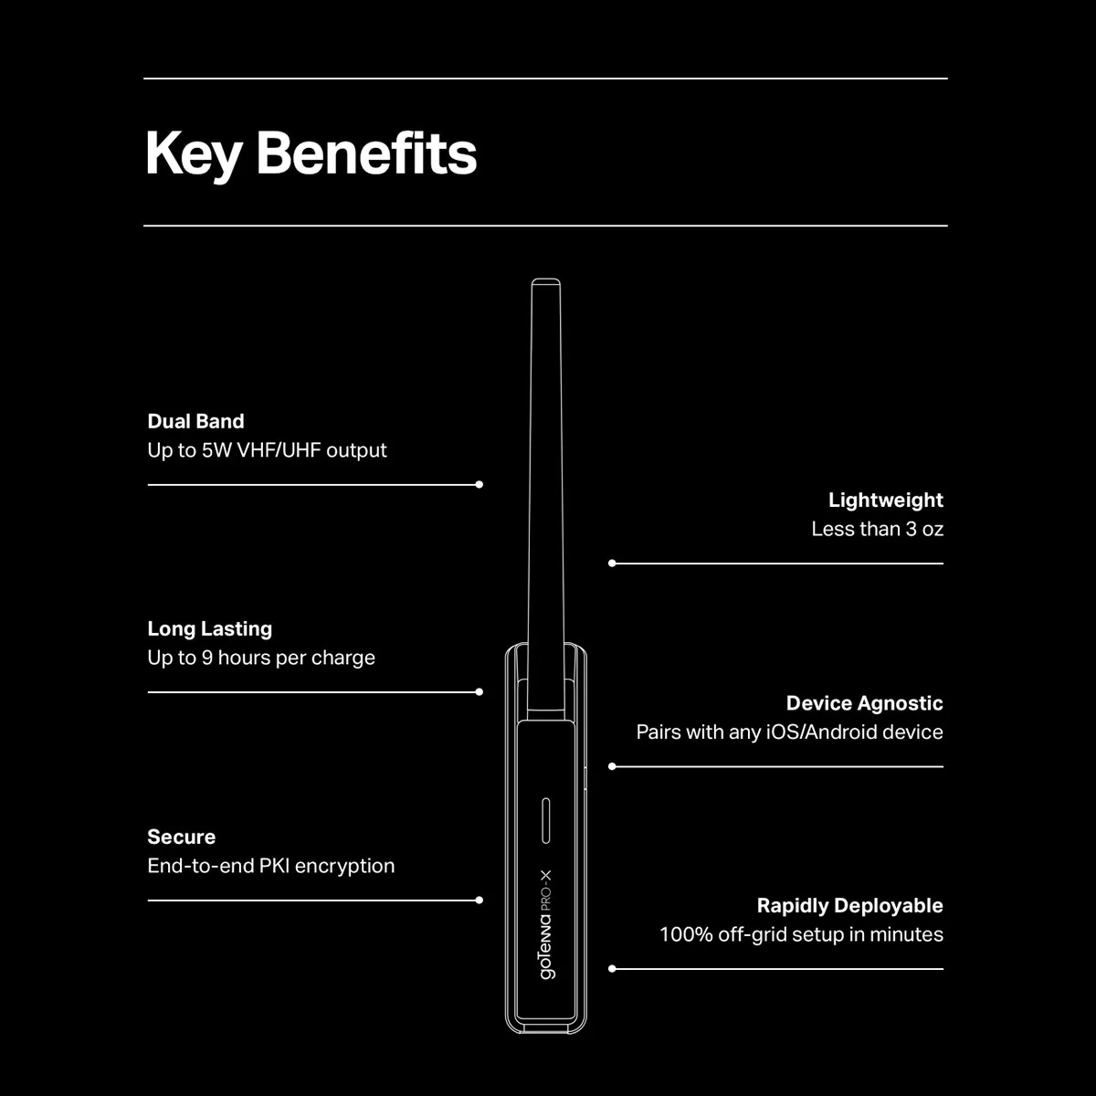
goTenna - Hardware
Lora Operating Frequency: 142 to 175 MHz (VHF)
445 to 480MHz (UHF)
Transmit Power: 27dBm (0.5W), 30dBm (1.0W),
33dBm (2.0W), 37dBm (5.0W)
Frequency Stability : 2.5ppm (-30°C, +60°C, +25°C Ref)
Digital RSSI Function

Slide 18
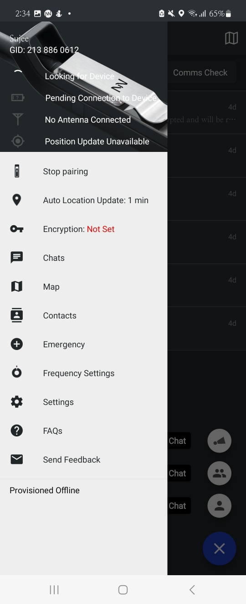
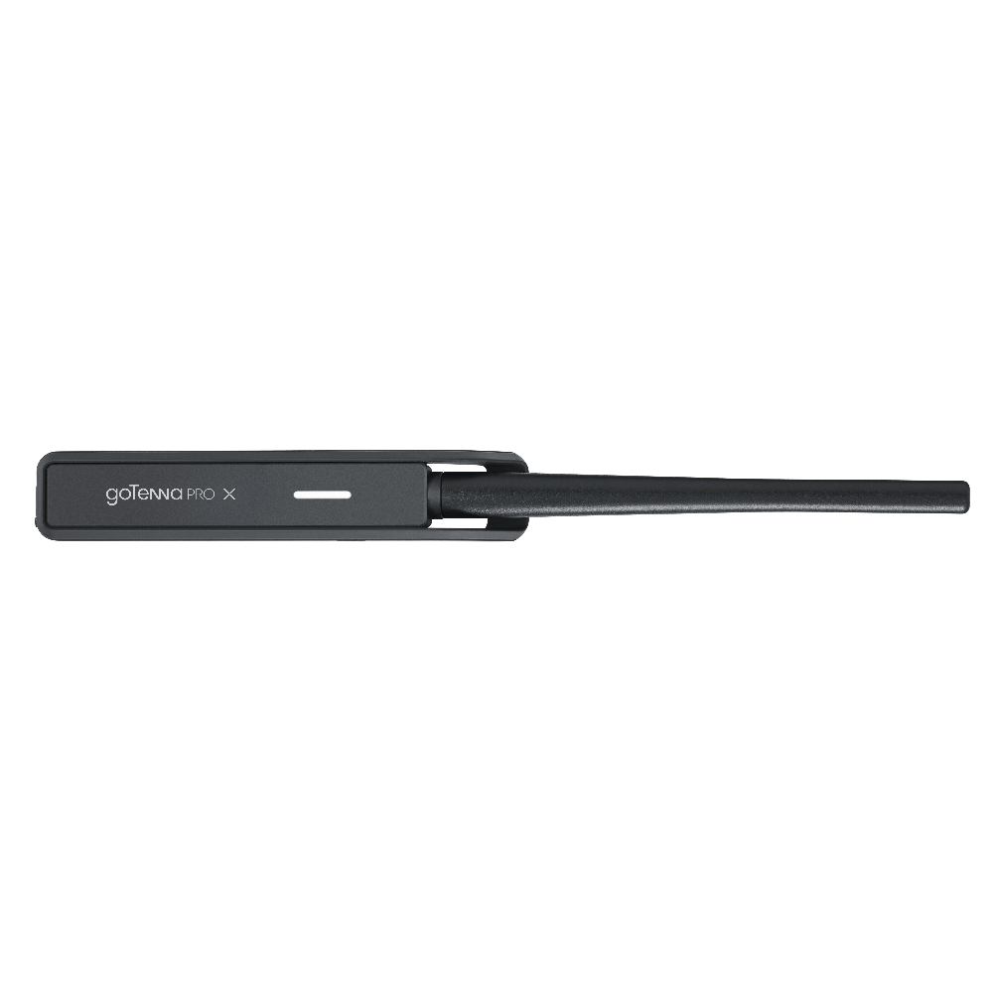
goTenna - Topology
_{[11]}
_{[11]}
goTenna Pro
Application
goTenna Pro
Application
BlueTooth
BlueTooth
ASPEN GROVE
MESH SUITE
ASPEN GROVE
MESH SUITE
LoRa
LoRa
_{[12]}
Hardware
_{[12]}
Hardware
[12]] tssi, “GoTennaProX-33_Blk.png,” Accessed: Jan. 29 2023 [Online]. Available: https://images.squarespace-cdn.com/content/v1/56b354e9b09f950655e35066/1588612917921-8ZKPQ5GYLJ3QCELNS18W/GoTennaProX-33_Blk.png
Notes:
고테나 클러스터덕 테스트 하는 방법 (+사용방법, setting 방법, 무슨 정보를 읽어들일지)

Slide 19
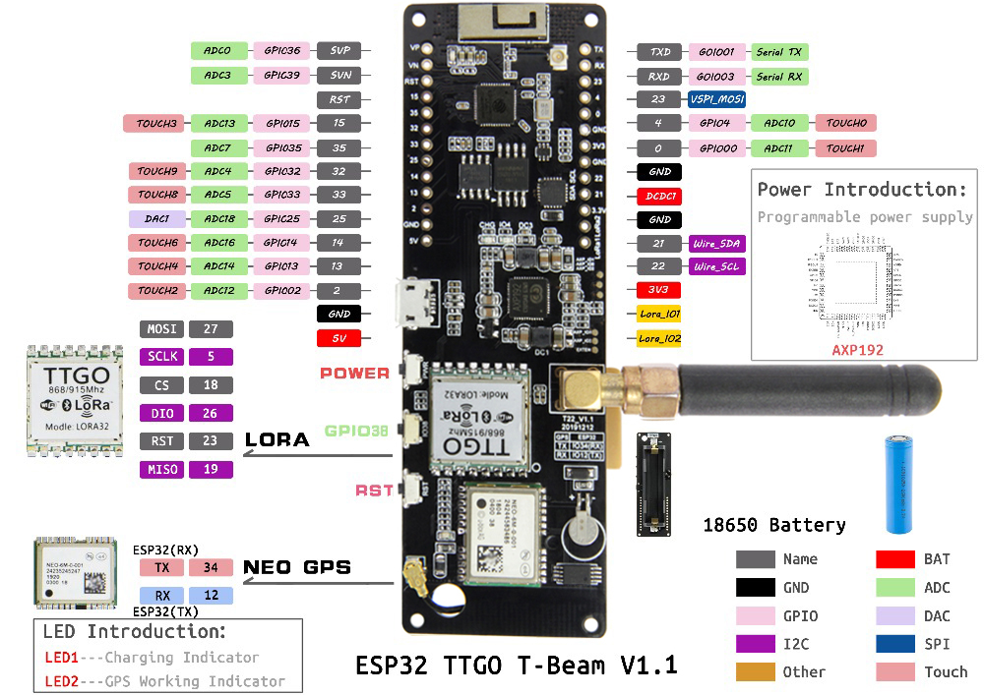
Meshtastic - Hardware
Lora Operating Frequency: 433/470MHz(433HMz version) /868M/915M(868MHz version)
Default Baud Rate: 115200
Frequency Error：+/-15KHz
Digital RSSI Function
Transmit Power: +20dBm
Data Rate ：0.018K~37.5Kbps@LoRa

Slide 20
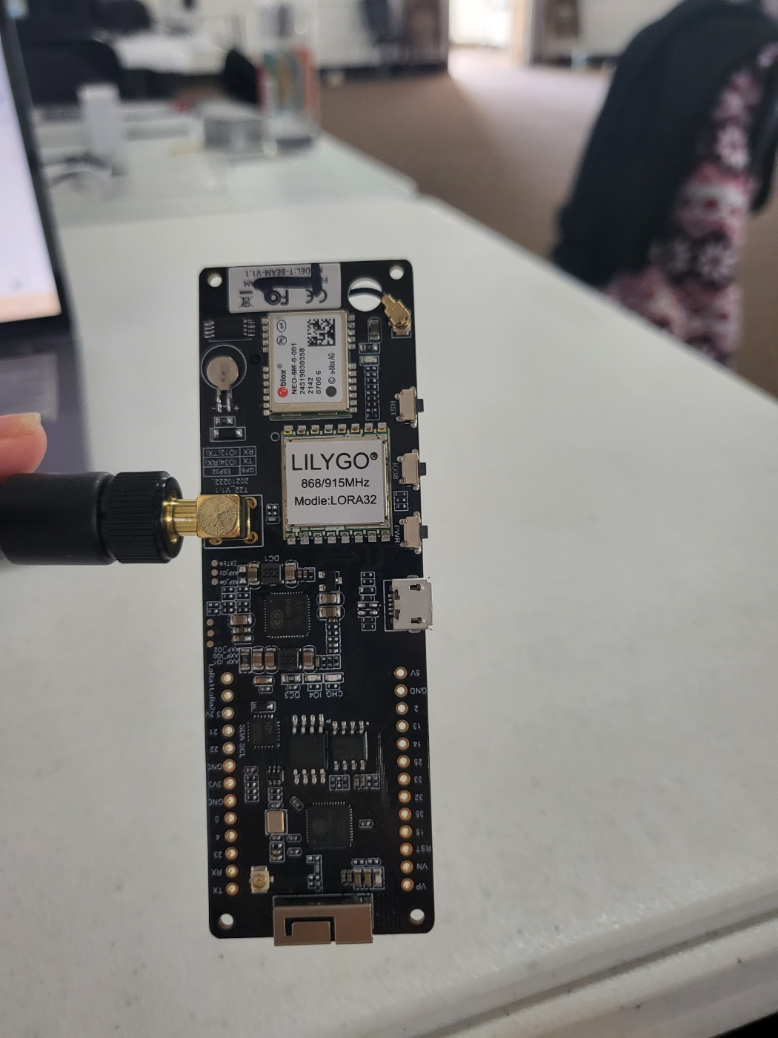
Meshtastic - Topology
_{[6]}
_{[11]}
_{[6]}
_{[11]}
Meshtastic
Application
Meshtastic
Application
BlueTooth
BlueTooth
Mesh
Broadcast
Algorithm
Mesh
Broadcast
Algorithm
LoRa
LoRa
Hardware
Hardware
Notes:
고테나 클러스터덕 테스트 하는 방법 (+사용방법, setting 방법, 무슨 정보를 읽어들일지)

Slide 21
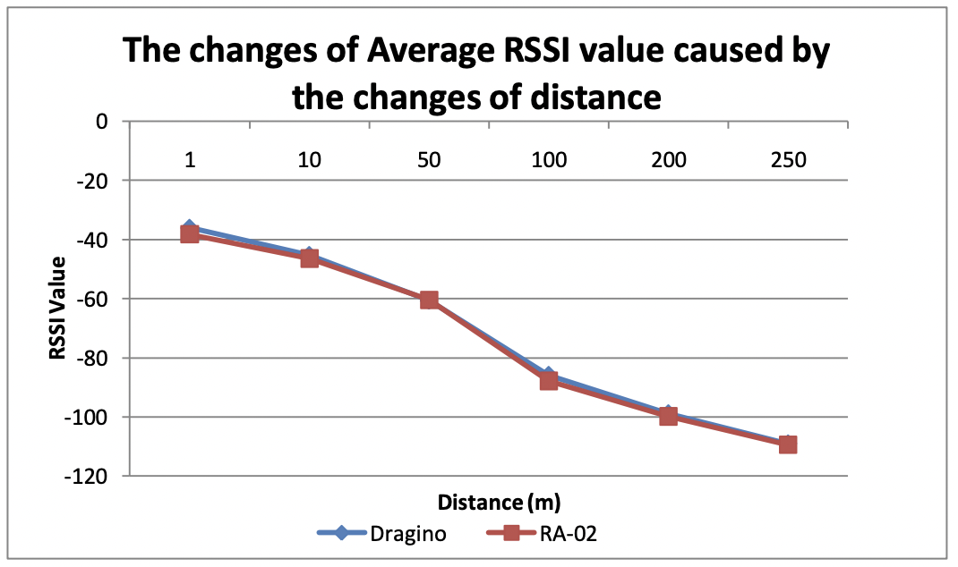
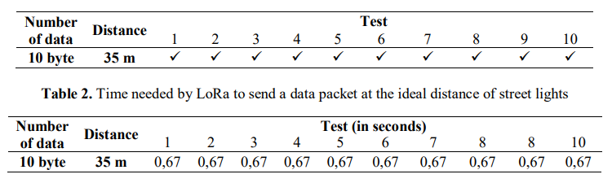
Information Gathering
Information to evaluate the performance of goTenna and Meshtastic
Distance
Time needed to transmit the data packet
RSSI
Packet loss rate
_{[12]}
_{[12]}
[12] R. Susanto, et al. “Comparison of three LoRa devices and its application on street light monitoring system” in IOP Conference Series: Earth and Environmental Science, 2018. p. 012066.
Notes:
Test result format (Paper - Comparison of three LoRa devices and its application on street light monitoring system)

Slide 22
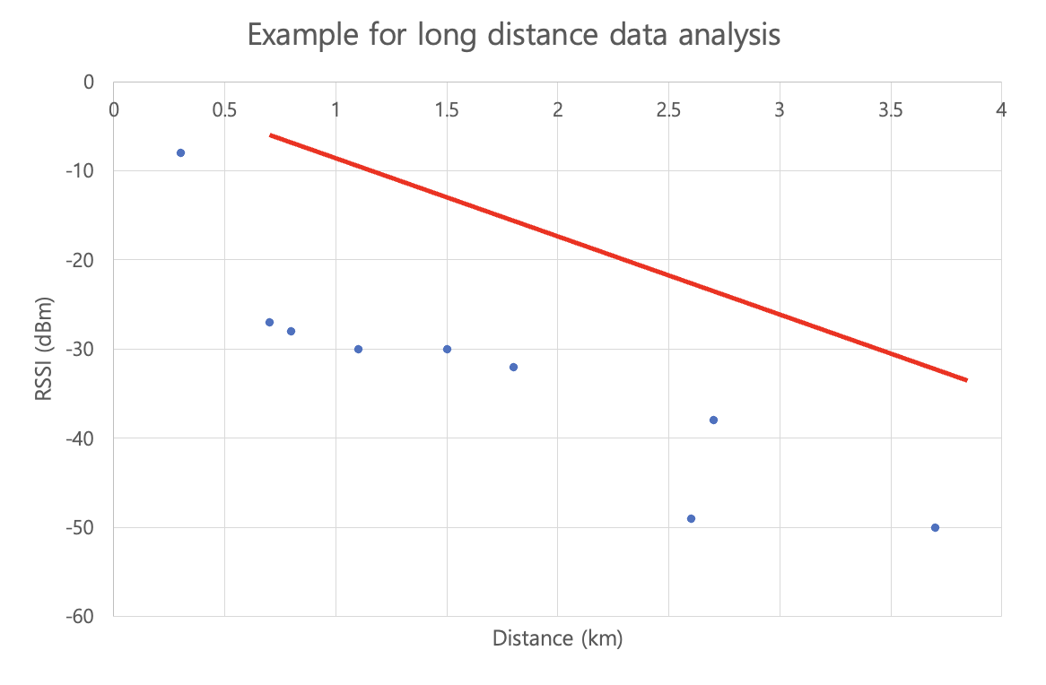
Testing based on connection distance
Path Loss in long distance, connection checking in short distance
Path loss is a decline in power density of any given electromagnetic wave as it propagates through space^{[21]}
In case of long distance connection, we can get a base line using path loss model when comparing the result of both devices
For short distance, check for association status, RSSI and airtime
Timestamp will be shown to the thousandths
ITM model path loss
Notes:
Test result format (Paper - Comparison of three LoRa devices and its application on street light monitoring system)

Slide 23
Models for calculating path loss
Paper | Evaluated path-loss models
[13] | free space path loss model Okumura Hata Model ITU-Advanced Channel Model for Urban Macro NLOS Ares Winner+ Channel Models for Urban Macro NLOS Areas 3GPP Spatial Channel for Urban Macro Areas Oulu channel model proposed Dortmund (urban) path loss model
[14] | 3GPP Rural Macro none-line-of-sight (NLOS) model (rural areas) 3GPP Urban Macro NLOS model (urban areas)
[15] | Free space path loss model Oulu Model
Okumura-Hata model tend to calculate path loss lower^{16]}
Free space path loss model estimated path loss higher^{[17]}
Oulu model predicts accurate RSSI in 3km^{[17]}
ITM model is more accurate than Oulu model^{[17]}
[13] Jorke ¨ et al., “Urban channel models for smart city iot-networks based on empirical measurements of lora-links at 433 and 868 mhz,” in 2017 IEEE 28th Annual International Symposium on Personal, Indoor, and Mobile Radio Communications (PIMRC), Oct 2017, pp. 1–6.
[14] Lauridsen et al., “Coverage comparison of gprs, nb-iot, lora, and sigfox in a 7800 km2 area,” in 2017 IEEE 85th Vehicular Technology Conference (VTC Spring), June 2017, pp. 1–5.
[15] Petajajarvi et al., “On the coverage of lpwans: range evaluation and channel attenuation model for lora technology,” in 2015 14th International Conference on ITS Telecommunications (ITST), Dec 2015, pp. 55–59
[16] N. S. Bezerra, C. Åhlund, S. Saguna and V. A. de Sousa, "Propagation Model Evaluation for LoRaWAN: Planning Tool Versus Real Case Scenario," in \emph{IEEE 5th World Forum on Internet of Things (WF-IoT)}, Limerick, Ireland, 2019, pp. 1-6, doi: 10.1109/WF-IoT.2019.8767299.
[17]L. Hendrik, et al. Path loss models for low-power wide-area networks: Experimental results using LoRa. VDE Verlag, 2018.
Notes:
Test result format (Paper - Comparison of three LoRa devices and its application on street light monitoring system)

Slide 24
Free space path loss model
The purely analytic FSPL (Friis equation) model serves as a baseline in analysis^{[17]}
d : the distance that is given in km
f : the frequency in MHz
Notes:
Test result format (Paper - Comparison of three LoRa devices and its application on street light monitoring system)

Slide 25
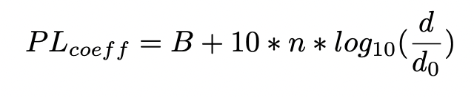
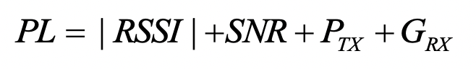
Oulu Model
^{[13]}
Based on their measurement data, the other authors derived a regression curve for the mean path loss
B : the path loss calculated by below formula
d : the distance between the node and the base station
d₀ : the 1 km reference distance
n : Path loss exponent
Notes:
Test result format (Paper - Comparison of three LoRa devices and its application on street light monitoring system)

Slide 26
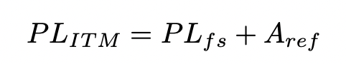
ITM model
various additional parameters to increase the accuracy of path-loss predictions like refraction and diffraction due to obstacles and terrain^{[17]}
The component Aref sums up possible attenuation in addition to the FSPL
Aref data is freely available thanks to Shuttle Radar Topography Mission (SRTM)^{[19][20]}
Earth Dielectric Constant | 5.0
Earth Conductivity | 0.001 [S/m]
Atmospheric Bending Constant | 301
Radio Climate | 5
Fraction of situations | 0.9
Fraction of time | 0.9
[19] Longley, Anita G and Rice, “Prediction of tropospheric radio transmission loss over irregular terrain. A computer method-1968,” Institute for telecommunication sciences boulder co, Tech. Rep., 1968.
[20] Hufford, Longley, and Kissick, “A Guide to the Use of the ITS Irregular Terrain Model in the Area Prediction Mode,” NTIA Tech. Rep. TR-82-100, no. April, p. 126, 1982. [Online]. Available: http://www.its.bldrdoc.gov/pub/ntia-rpt/82-100/
Notes:
Test result format (Paper - Comparison of three LoRa devices and its application on street light monitoring system)

Slide 27
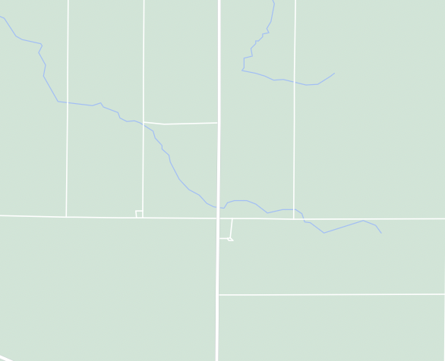
Testing - Outdoor
Increasing the distance, collect data for evaluation
Testing starts in plain like farm
Increasing the distance slowly
Move until signal is ended
The goal of the experiment is to check maximum available distance of each device
Notes:
Test result format (Paper - Comparison of three LoRa devices and its application on street light monitoring system)

Slide 28
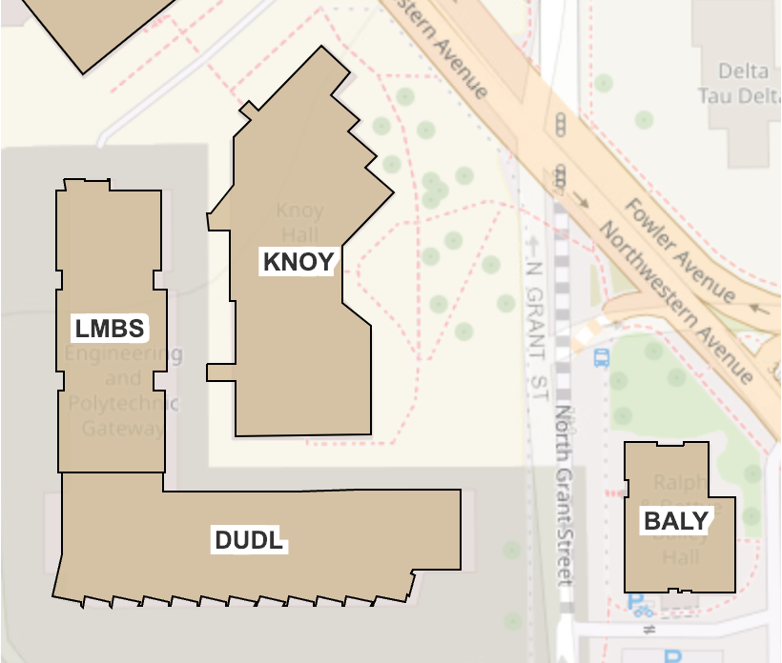
Testing - Outdoor to Indoor
Test in different buildings and floor
Testing will be conducted in each different floor and building
Check if connection is available or not
Hop count is important factor to figure out network connection
The goal of the experiment is to examine the usability in normal circumstance
rooftop
4th floor
2nd floor
1st floor
Notes:
Test result format (Paper - Comparison of three LoRa devices and its application on street light monitoring system)

Slide 29
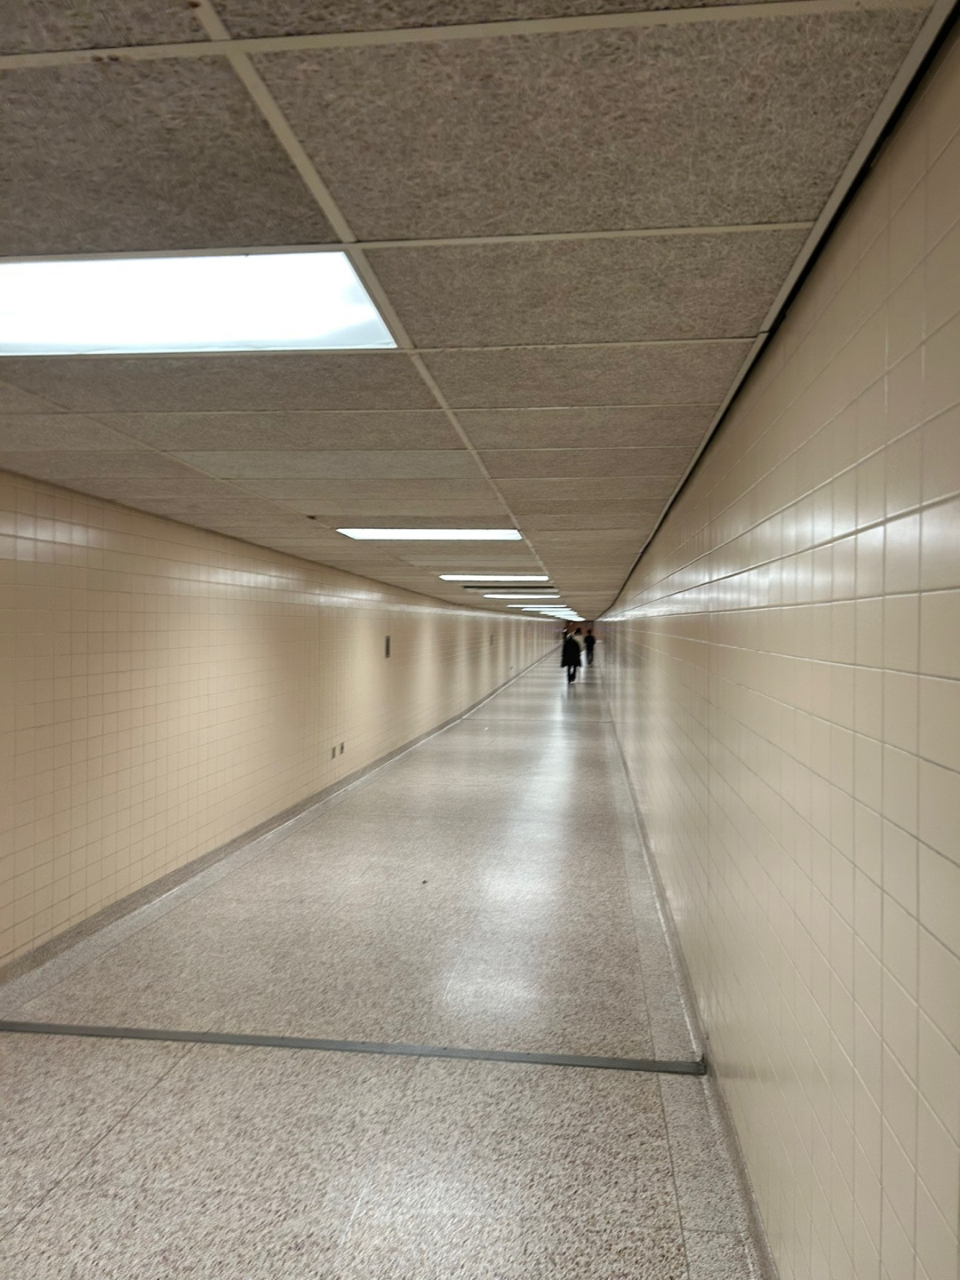
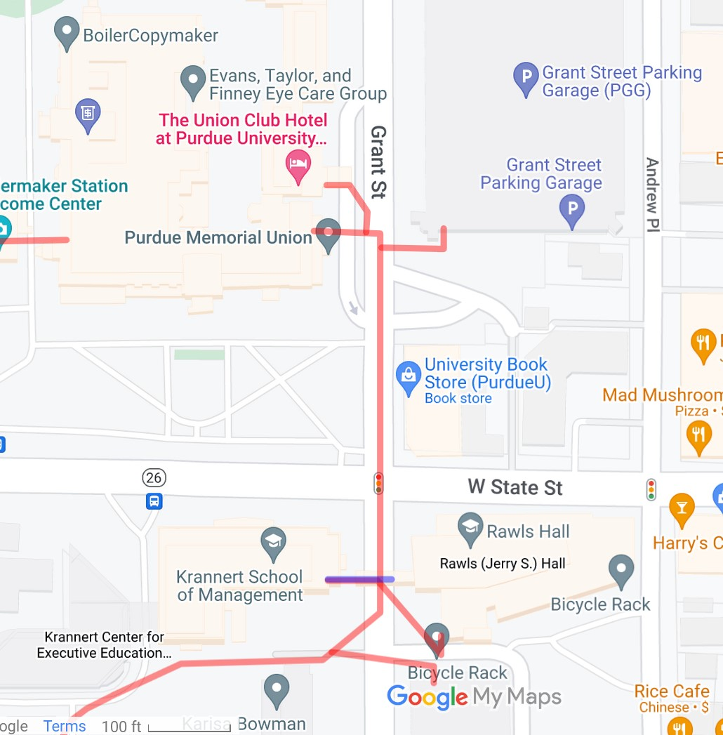
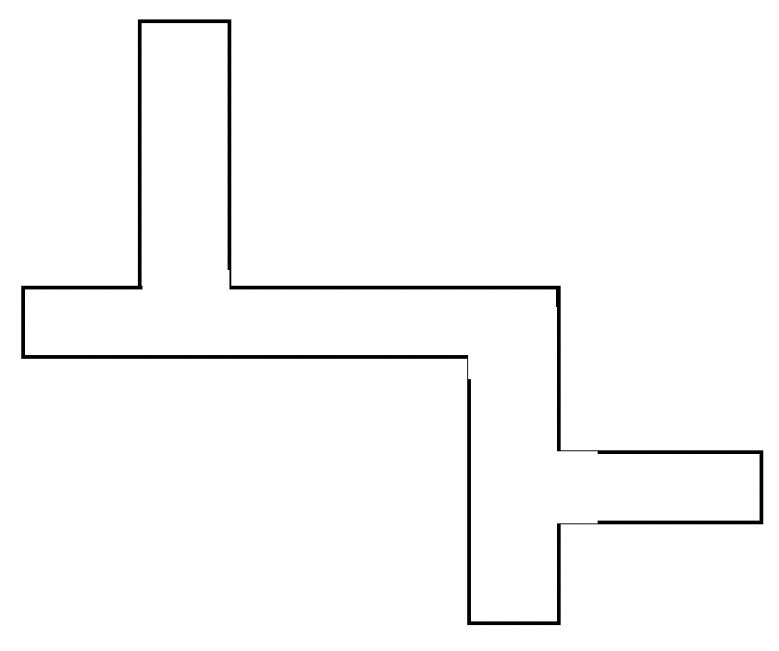
Testing - Tunnel
Test in different buildings and floor
In tunnel, RF signal is reflected on the walls and ceiling.
The circumstance make RF signal hard to transfer
The experiment is conducted in PMU tunnel
Four devices check the connections, delay time and RSSI
Notes:
Test result format (Paper - Comparison of three LoRa devices and its application on street light monitoring system)

Slide 30
Future Plans
04

Slide 31
Present
What we have done so far…
Chose a topic
Jan 6th
Researched related work
ClusterDuck Setting
1st Draft of Paper
GoTenna Setting
Switched to
Meshtastic
Simple operation testing
Notes:
지금까지의 현황 (간단한 테스트 뭐 이런거 + 논문 relatedwork까지 작성)

Slide 32
Future
What we will do afterwards…
Previous work
Visualize and
Analyze Results
Select Testing Zones
Test Both Devices
Final
Paper
Final
Presentation
end of Feb

Slide 33
Q & A
05

Slide 34
Thank you!
Team: GO duck
presentation. Sujee Noh, Younguk Maeong
Q&A. Gwangyeok Kim, Keonwoo Lim
Thanks to. Baylasan, Xavier

